Slide 1


NEXT GEN EMPLOYABILITY PROGRAM
CREATING A FUTURE-READY WORKFORCE
Student Name :
Mansi Raut
Student ID :
College Name :
STU65e1b3a42dd5a1709290404
Trinity College of Engineering And Research,Pune

Slide 2
CAPSTONE PROJECT SHOWCASE
Project Title
Car Rental Application Using Django Framework
Abstract | Problem Statement | Project Overview | Proposed Solution | Technology Used | Modelling & Results | Conclusion | Q&A

Slide 3
Abstract
1
User Authentication and Management.
2
Car Inventory Management.
3
Admin Panel for controlling and monitoring.
4
Booking and Reservation System.

Slide 4


Problem Statement
Optimizing Fleet Utilization: Develop a solution to optimize the utilization of the car rental fleet by efficiently managing the allocation of vehicles to meet customer demand while minimizing idle time.
Enhancing User Experience and Accessibility: Create features to enhance the user experience and accessibility of the car rental platform

Slide 5

Project Overview
1. Introduction:
The car rental application aims to provide a user-friendly platform for renting vehicles to customers. It offers a wide range of vehicles from various manufacturers, allowing users to easily find and book the car that suits their needs.
2. Features:
Incorporate functionalities for user authentication, car inventory management, booking and reservation systems, user profile management, and admin dashboard for monitoring and managing the application.
Overall, the project strives to deliver a comprehensive solution for online car rentals, ensuring convenience, reliability, and security for both users and administrators.

Slide 6
Proposed Solution
User Authentication and Profiles: Implement a robust authentication system for users to securely sign up, log in, and manage their profiles, ensuring data privacy and security.
Dynamic Car Inventory Management: Develop a dynamic inventory management system to add, update, and remove cars, with real-time availability status, enabling users to easily find and book vehicles based on their preferences and requirements.
Streamlined Booking Process: Create an intuitive booking process allowing users to search for available cars, select rental dates, and make reservations seamlessly.
Administrative Dashboard: Develop an admin dashboard for administrators to oversee the application's operations, manage users, monitor bookings, and generate reports, providing insights for optimization and decision-making.

Slide 7
Technology used
Backend: Django framework with Python for server-side logic and database management.
Frontend: HTML, CSS, JavaScript, and Bootstrap for the user interface.
Database: SQLite3 for storing car listings, user data, reservations, and other application information.
Authentication: Django's built-in authentication system with secure password hashing and session management.

Slide 8
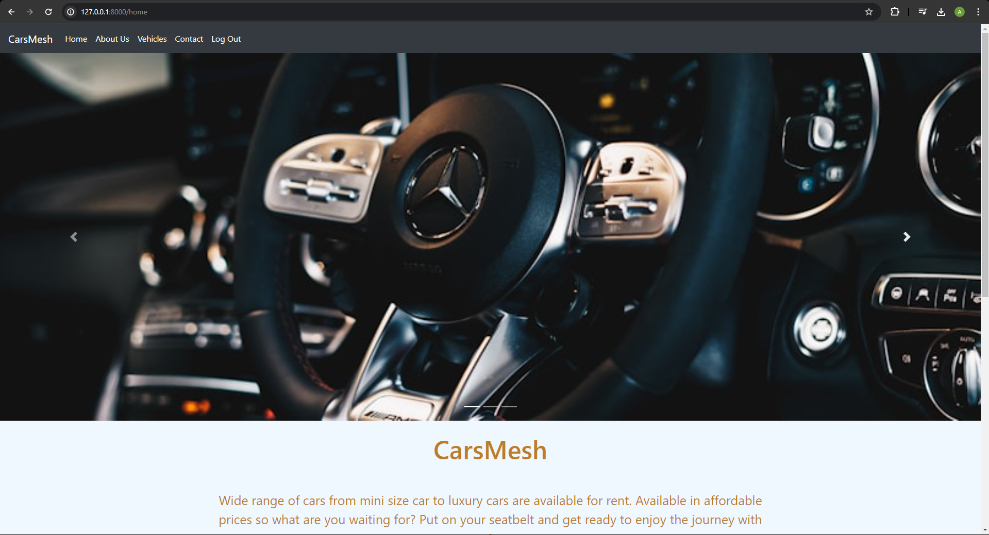
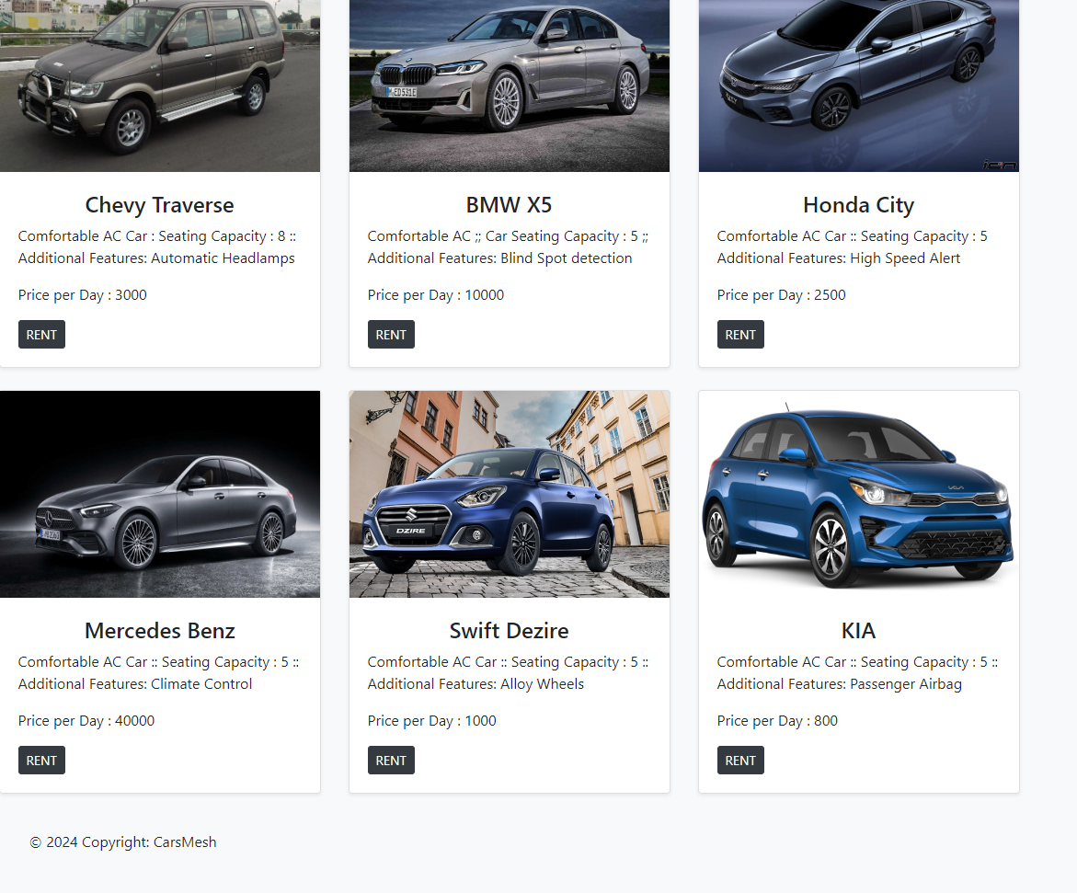
Modelling & Result

Slide 9
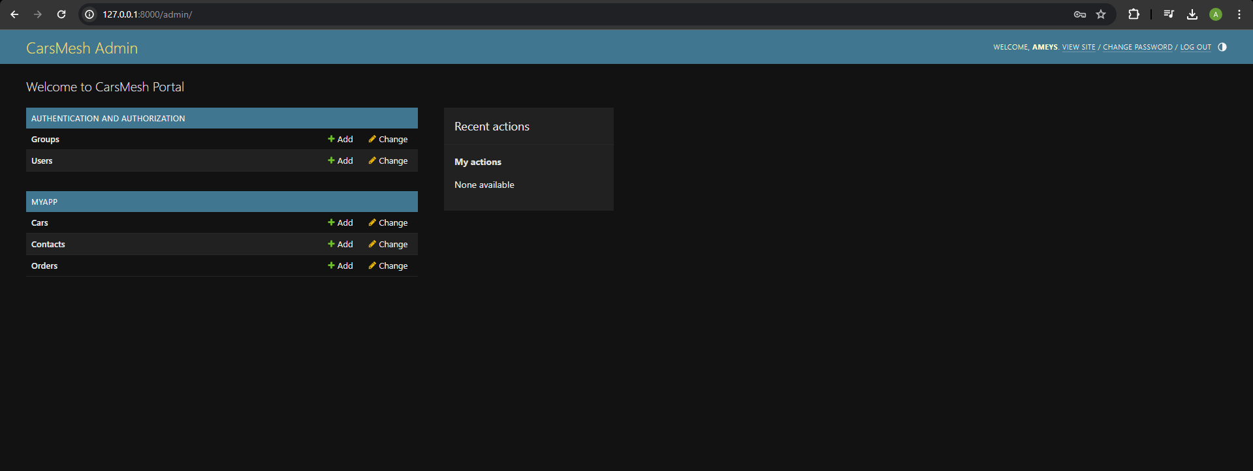
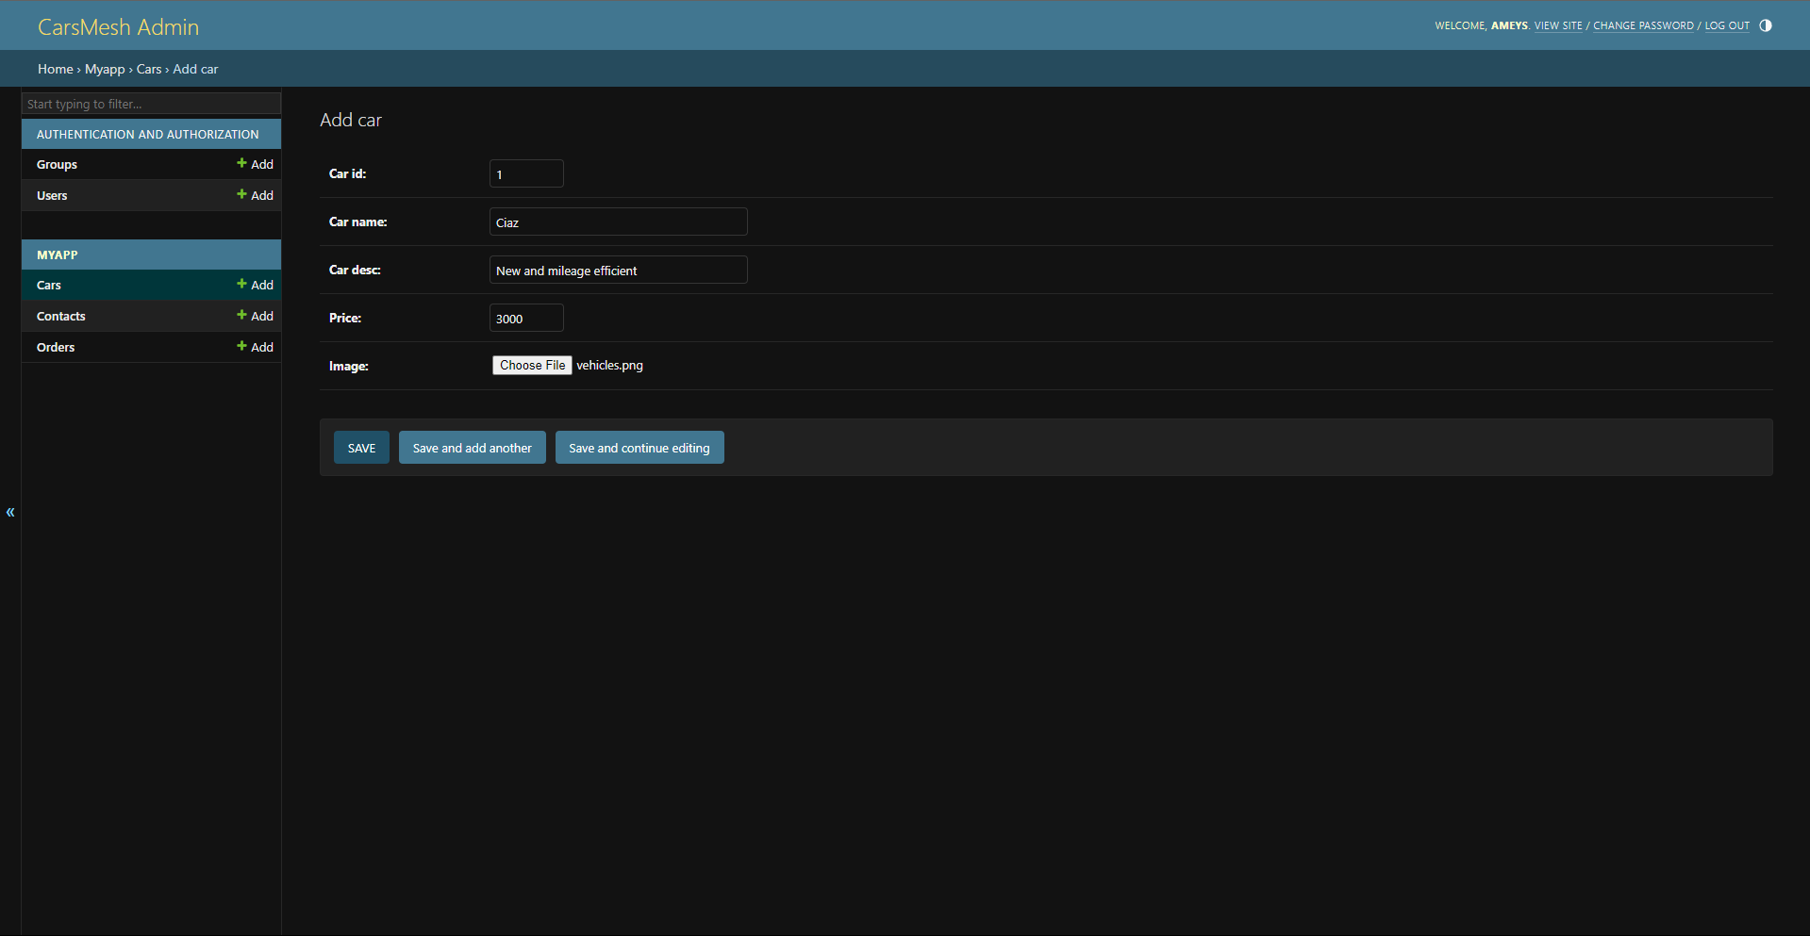
Modelling & Result

Slide 10
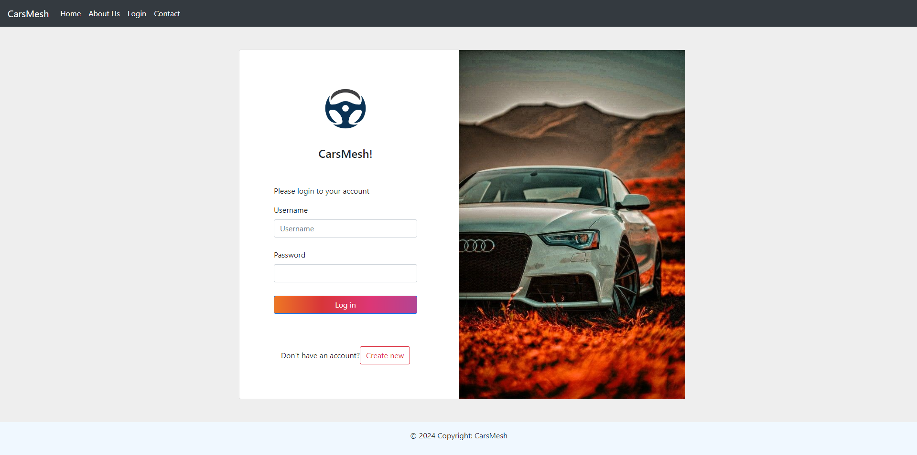
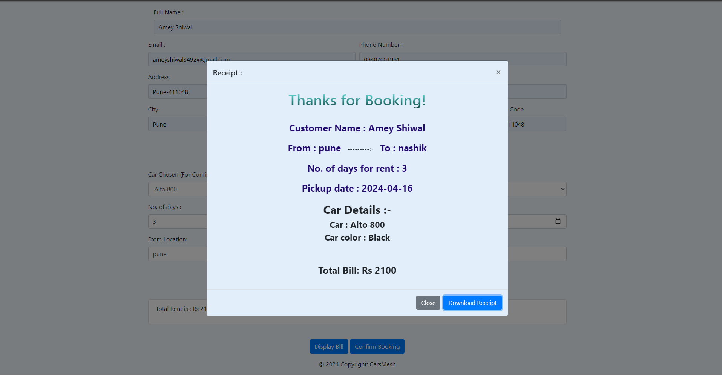
Modelling & Result

Slide 11

Conclusion
Aim to provide a comprehensive solution for online car rental, ensuring a seamless experience for users and administrators through intuitive design, robust features, and secure functionality.

Slide 12


Notes:
Thank You !!

